Slide 1
Cardiovascular Predictive Analysis
By Paskalis Agung N. Koten

Slide 2
Outline
1
Introduction
2
Exploratory Data Analysis
3
Data Preparation
4
Modeling Machine Learning And Evaluation
5
Conclusion and Recommendation

Slide 3
01 Introduction

Slide 4
Background
Cardiovascular disease (CVD), listed as the underlying cause of death, accounted for 928,741 deaths in the United States in 2020.
The Behavioral Risk Factor Surveillance System (BRFSS) United States, they were surveyed of each individual about the behavior which potential to cardiovascular disease. Their goal is to give preventive services for people has potential cardiovascular disease.
Between 2017 and 2020, 127.9 million US adults had some form of CVD. Between 2018 and 2019, direct and indirect costs of total CVD were $407.3 billion
The goal of these project is :
Build a model for prediction, Does someone have the potential for cardiovascular or not
*Based on American Heart Association in 2020

Slide 5

Research Question
I’m limiting the topics with questions below, so our discussion is not going widely.
How to make a model to predict cardiovascular disease
Which is the best model to use prediction of cardiovascular disease
What is the importance of the features that influence the model to make a prediction?

Slide 6
02 Exploratory Data Analysis

Slide 7
Data Set Information
Features | Type | Information
General_Health | object | 5 Unique Value
Checkup | object | 5 Unique Value
Exercise | object | 2 Unique Value
Skin_Cancer | object | 2 Unique Value
Other_Cancer | object | 2 Unique Value
Depression | object | 2 Unique Value
Diabetes | object | 4 Unique Value
Arthritis | object | 2 Unique Value
Sex | object | 2 Unique Value
Age_Category | object | 13 Unique Value
Height_(cm) | float64
Weight_(cm) | float64
BMI | float64
Smoking_History | object
Alcohol_Consumption | float64 | 2 Unique Value
Fruit_Consumption | float64
Green_Vegetables_Consumption | float64
FriedPotato_Consumption | float64
Features :
There are 18 columns,
All column type already correct
Target :
Heart_Disease
‘Yes’ → Positive CVD, labeling as 1
‘No’ → Negative CVD, labeling as 0
There are 308854 row
Target | type | Information
Heart_Disease | object | 2 Uniqe Value

Slide 8

Data Cleaning
Overall, there’s no null value on data set. However there’s a duplicate value, and we delete the duplicates, because duplicates value will make model confuse
Before
After
308695 row
308854 row

Slide 9
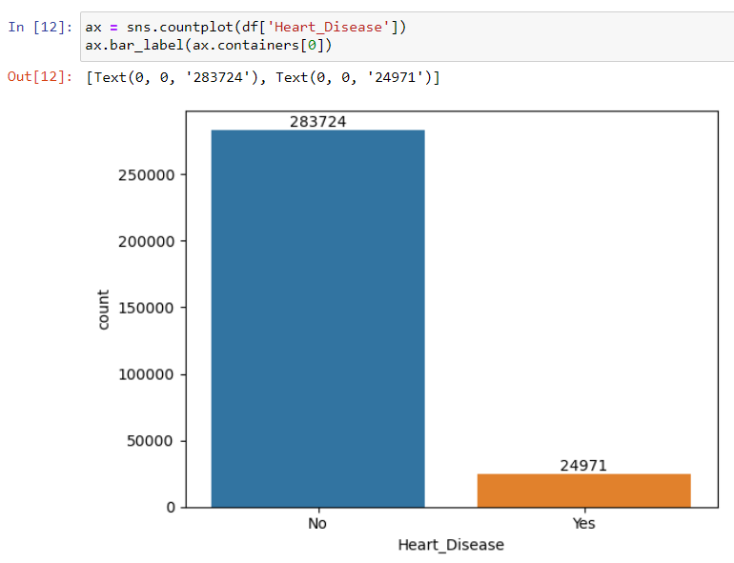
What inside the target
24971 people from 308965 or 8 % of the data set have cardiovascular.
The target (Heart_Disease) is imbalance, this is not good to learn by the model because the model would be more understand negative than positive cardiovascular. So, we need some treatment for balancing the target. In This case, I would like to use under-sampling. How many rows to erase and how many rows remain will be explained further.

Slide 10
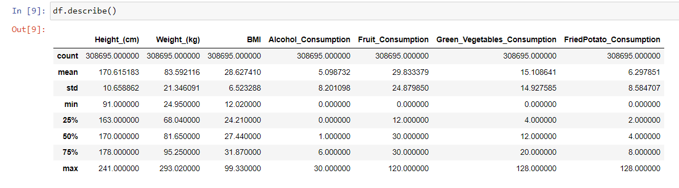
Statistical Summary
Height and weight are abnormal, look at the red rectangle on the minimum value. The height is 91 cm, whereas the minimum age is 18 years old. We will see the details further..

Slide 11
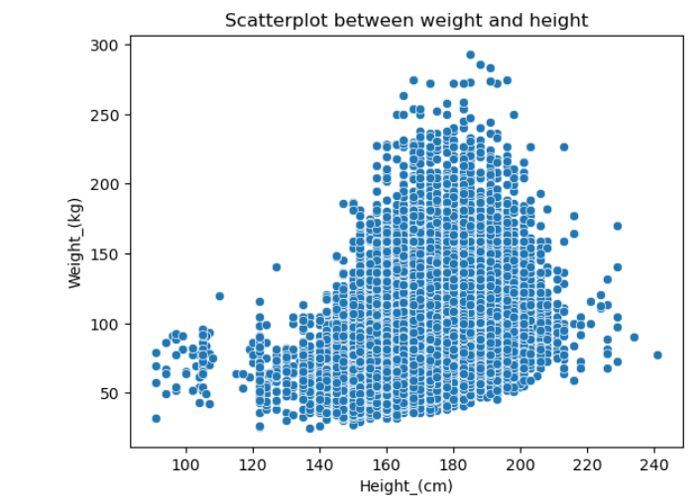
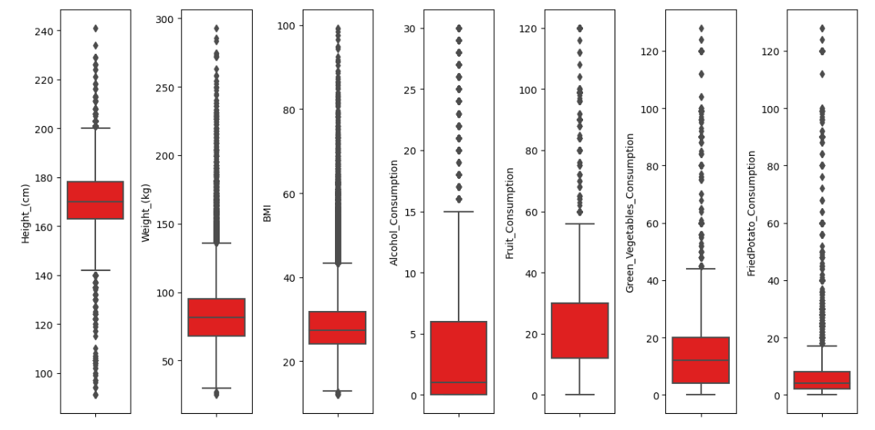
Univariate Analysis Data Numerik
124263 rows contain outliers. This amount is equivalent to 40 % of the row in the data set. I decided to delete all these outliers for modeling.
Looks like there are a lot of cases of abnormal body weight and height, like obesity or dwarfism

Slide 12
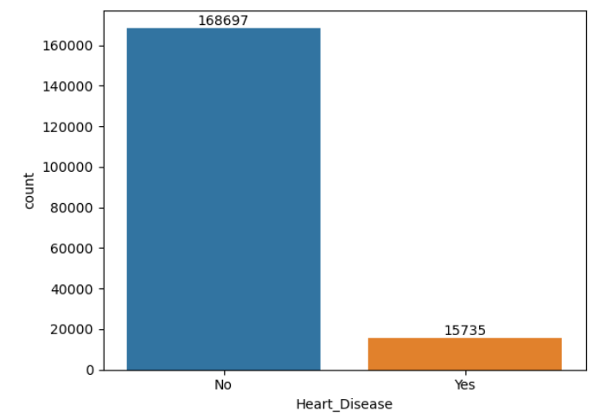
Data set without outliers
I use IQR method to separate which outlier or not
Outliers :
If value < (Q1 – 1.5(IQR) ) or
value > (Q3 +1.5(IQR))
Where :
Q1 = first quartile of data
Q3 = third quartile of data
And
IQR = Q3 – Q1
After deleting all outliers, the amount of target still represents the original data. There is still an imbalance target.
- 40 %
Before
308695 row
After
184432 row

Slide 13
03 Data Preparation

Slide 14
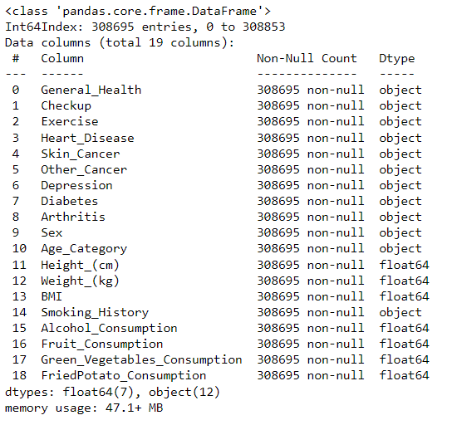
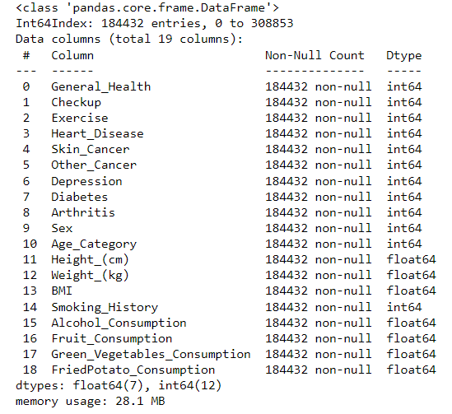
Convert Object Type to Numeric Type
Since machine learning just understands numeric values, I convert column objects into numeric ones.That column which type of object has 2 unique values ( yes/no ) I convert into (1 and 0 ). Where 1 = Yes, and 0 = No.For column like General_Health, Checkup, Age_Category, Weight_Category I treated ordinal encoding
BEFORE
AFTER

Slide 15
Train, Test and Validation Split
Data Set
Data validation is 57 % of data train
Validation still represent the original condition of target. 8 % of data has cardiovascular
90 % data train will under sampling
10 % Validation
Where parameter :
100 % Majority
80 % Minority
There are 18444 row
Where the amount of target value
No : 16845
Yes : 1599
Data train
There are 31806 row
Where the amount of target value
Yes : 14136
No : 17670

Slide 16
Base Line Model
Table of result base line model
To choose which is the best model, I did it on the baseline model. Where the features learned by the model is just numeric column, without feature engineering treatment. In other words, just the way it is.
The model that I tested is :
1. Logistic Regression
2. DecisionTree Classifier
3. RandomForest Classifier
4. GradientBoosting Classifier
Model | Precision | Recall | F1 Score
Logistic Regression | 0.22 | 0.73 | 0.34
Decision Tree | 0.16 | 0.62 | 0.26
Random Forest | 0.23 | 0.74 | 0.35
Gradient Boosting | 0.23 | 0.76 | 0.36
Note :
Data set splitted like previous slide
Under sampling data train
The metric reference for the best is from F1 score and recall
4. The best model is gradient boosting classifier

Slide 17
04 Modeling and Evaluation

Slide 18
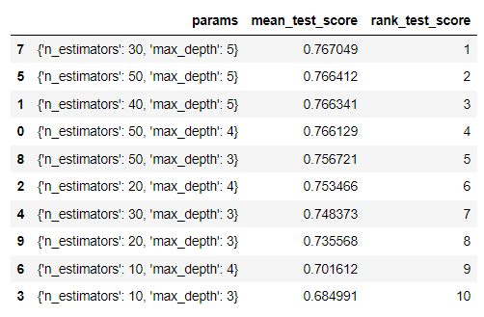
Modeling and Evaluation
Since gradient boosting is the best model based on base line. Next, I find the best parameter to improve the metric (Hypertuning parameter).
RESULT
 | Precision | Recall | F1
Training | 0.72 | 0.78 | 0.75
Validation | 0.23 | 0.78 | 0.35
interpretate model :
best model is on parameter n_estimators : 30 and max_depth : 5
precision metric has an overfitting, where training model higher than validation
recall is metric we focus on. from all occurrence heart disease, the model catch 78 %
precision metric 23 % is mean that, from all true positive prediction made by the model. only 23 % that true positive
Best model with parameter :
n_estimator : 30
Max_depth : 5

Slide 19
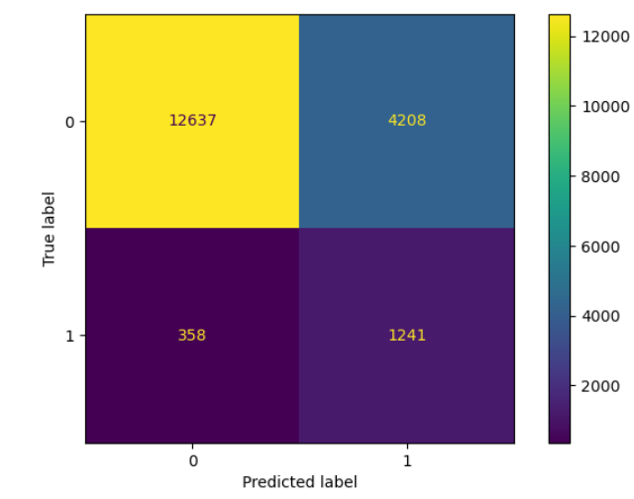
Interpretation of model performance based on validation data set
68,51 %
22,81 %
6,72 %
1,94 %
68,51 %
22,81 %
6,72 %
1,94 %
I
III
IV
II
The left picture, is confusion matrix. It’s representation the result of model prediction compare with actual data.
True Positive (TP) : 1241 row or 6,72 %
True Negative (TN) : 12637 row or 68,51 %
False Positive (FP) : 4208 row or 22,81 %
False Negative (FN) : 358 row or 1,94 %
The right picture is representation distribution from the result of model prediction.
Circle I : All row of validation data
Yellow : True Negative
Circle II and red : The row that predicted as False Negative. We lost them
because they are positive cardiovascular.
Circle III : All row who predicted as True Positive
Green : False Positive (FP)
Circle IV and blue : The row which is the true positive (TP)

Slide 20
Estimation potential impact of model
For example, if there are 100 out of 300 people who are sick with CVD, 78 people from them will be predicted as true positive. But, because since the precision metric is 23 %, there are a lot of people who will predicted as positive by the model, which will confuse
According to a study conducted in USA, the total mean direct medical care costs for patients with established cardiovascular disease (CVD) was 18,953 US dollar per patient per year with inpatient costs being 42.8% ($8114) of total costs
so, if we can prevent of 78 person who has potential cardiovascular. we could save $1.5 million of costs

Slide 21
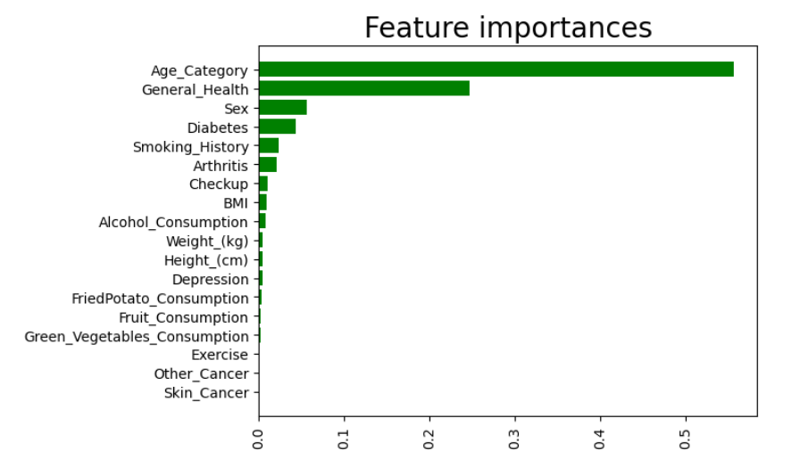
Feature Importance
observation :
1. features importance in above is global feature importance
2. Top feature mostly is categorical data, such as age category, general health, check-up, sex, diabetes, smoking history, and arthritis.
3. Feature importance on the model does not represent of correlation to the target, but we can associate those as features that most contribute for model to predict true or false.
4. consumption behavior is low contribution for model to predict

Slide 22
05 Conclusion and
Recommendation

Slide 23
Conclusion
The model for prediction of cardiovascular disease has been made with a Gradient-boosting classifier. Since there are a lot of outlier in the numeric column, I decided to delete all outliers because it is abnormal dat
The gradient Boosting classifier has been chosen as the best model based on the baseline model, with parameter n_estimators = 30, max_depth = 5. With performance recall = 0.78, precision = 0.23, and F1 score = 0.35, since the target has imbalance classes it causes overfitting on precision metric
The top feature is important to the target is age category, general health, check-ups, sex, diabetes, smoking history, and arthritis. Which is all of these factors is similar to factor of cardiovascular disease

Slide 24
Recommendation
Since precision metric is low, here is some of recommendation action :
use this model as the first filtering for predictive, If someone predicted by the model is positive cardiovascular then take a medical chekup by medical for make sure, it is true positif or not. The advantage of using this model, you can save time in checking all patients on the data set, you just need to check 29 % of patients from the data set.
consultation with a specialist in cardiovascular about the features, we still can explore new features that contain the behavior of the patient, make it more detailed and relevan to target. So, the model could be more accurate
About feature importance, don't use this as reference of factors that causes cardiovascular, instead investigation and observation of each patient is needed for further
Investigate more further of outliers, especially weight and height body. It is valid or not
Give education about cardiovascular to people, any factor that impact to cardiovascular and how to reduce the potential

Slide 25
Thank You

